Slide 1
GENERATIVE AI LLM Quantization Techniques – Comparative Analysis
Presented By
Rajasekhar Reddy Palavali
Jidigam Venkata sai pavan kalyan
Pavithra PN
Sneha Pramanik
Sogala Rahul
Santhosh Kumar H N

Slide 2
Introduction
Large Language Models (LLMs) are powerful artificial intelligence models used for tasks such as text generation, question answering, and natural language understanding. They are trained on large datasets and contain millions or billions of parameters, making them highly accurate and capable. However, their large size requires high memory and computational resources, which makes deployment difficult on devices with limited hardware. Additionally, high resource usage increases latency and operational cost. To address these challenges, optimization techniques are used. One important technique is quantization, which reduces the precision of model parameters. This helps decrease model size, improve inference speed, and enable efficient deployment while maintaining acceptable performance.

Slide 3
Objective
Optimize LLMs by reducing size and improving efficiency
Apply quantization techniques for model compression
Evaluate performance improvements
Compare original and quantized models
Analyze results based on:
Speed
Memory Usage
Output Quality

Slide 4
Models Used & Quantization
🟢 GPT-2 Model
Pre-trained model for text generation
Applied multiple quantization techniques (INT8, INT4, GPTQ)
Helps reduce memory usage and improve speed
🔵 LLaMA-2 (7B) Model
Advanced large language model
Applied quantization techniques (NF4, EXL2, NVFP4)
Provides efficient performance with reduced size
⚙️ Tools Used
BitsAndBytes → Used for quantization
AutoTokenizer → Used for text processing

Slide 5
What is Quantization?
Quantization is a technique used to reduce the precision of model weights
Converts higher bit values (32-bit) into lower bits (8-bit, 4-bit)
Helps in:
Reducing model size
Lowering memory usage
Improving computation speed
Slight impact on accuracy, but increases efficiency
Makes models suitable for real-world deployment
Diagram:-
32-bit → 8-bit → 4-bit
Large Medium Small
Slow Faster Fastest

Slide 6
Techniques Used
Quantization techniques reduce the precision of model weights.
Help in decreasing model size and improving efficiency.
INT8 provides a balance between accuracy and performance.
INT4 offers higher speed with slight reduction in quality
Advanced techniques like GPTQ, NF4, EXL2, NVFP4 further optimize models
Improve memory usage and inference speed
Applied on both GPT-2 and LLaMA-2 for comparison
Diagram:-
INT8 → Medium Size → Good Accuracy
INT4 → Small Size → Faster (Slight Quality Loss)
GPTQ → Optimized Quantization → Better Efficiency
NF4 → 4-bit Optimized → Memory Efficient
EXL2 → High Compression → Faster Inference
NVFP4 → Ultra Low Precision → Maximum Efficiency

Slide 7
Implementation
Loaded pre-trained models (GPT-2, LLaMA-2)
Applied multiple quantization techniques (INT8, INT4, GPTQ, NF4, EXL2, NVFP4)
Processed input using tokenizer
Generated outputs using sample queries
Diagram:-
➡Load Model → Apply Quantization → Input Query → Generate Output

Slide 8
Testing
Provided sample text inputs
Ran queries on different models and quantization techniques
Collected outputs for performance analysis and comparison
Diagram:-
➡ Input Query → Model → Output → Comparison

Slide 9
Results
Quantization significantly reduces memory usage
Improves inference speed of the models
Causes a slight decrease in output quality
Overall performance remains efficient and practical
Diagram:
Speed ↑
Memory ↓
Quality ↓ (slight)

Slide 10
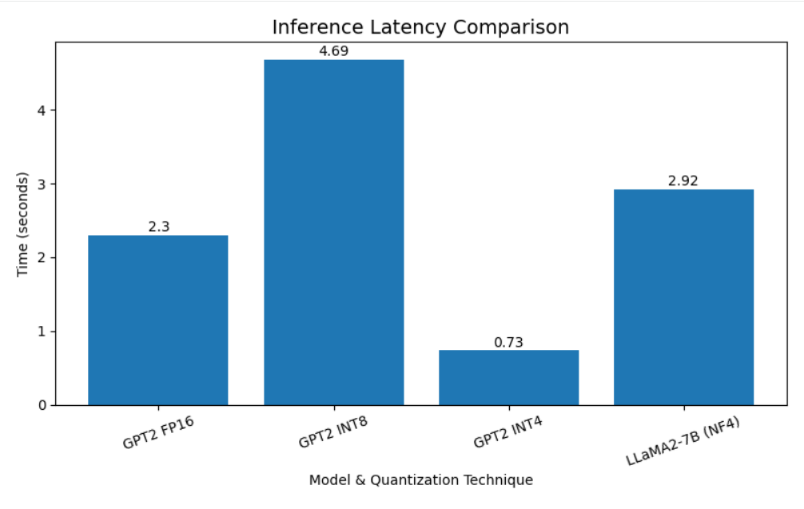
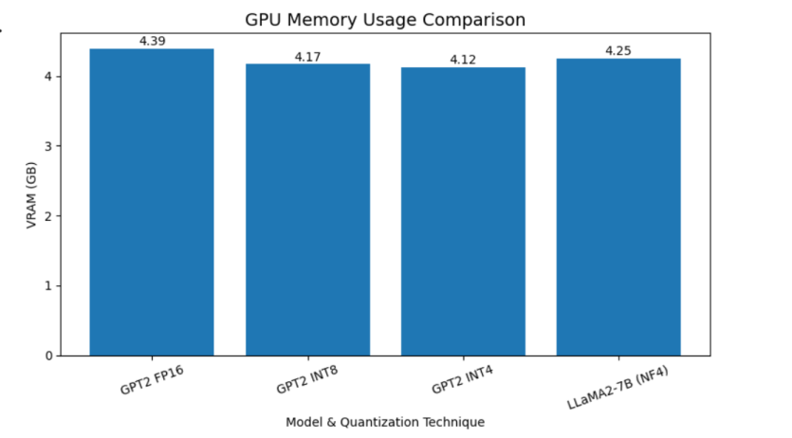
Charts

Slide 11
Comparison Quantized models improve speed and memory efficiency Normal models provide slightly better output quality Shows a trade-off between efficiency and accuracy
Comparison: Normal vs Quantized Model
Feature | Normal Model | Quantized Model
Model Size | Large | Reduced
Memory Usage | High | Low
Speed | Slower | Faster
Output Quality | High | Slightly Reduced

Slide 12
Challenges
Faced rendering errors during execution
High memory usage for large models
Difficulty in applying multiple quantization techniques
Managed by optimizing configurations and workflow
Diagram:
Problems → Solutions
Rendering Issue → Fixed configuration
High Memory → Used quantization
Complexity → Simplified workflow

Slide 13
Conclusion
This project demonstrates that quantization is an effective technique for optimizing Large Language Models. By reducing the precision of model weights, it significantly decreases memory usage and improves processing speed. Although there is a slight trade-off in output quality, the overall performance remains efficient and acceptable. Therefore, quantization provides a practical solution for deploying large language models in real-world applications.

Slide 14
THANK YOU!

